Slide 1

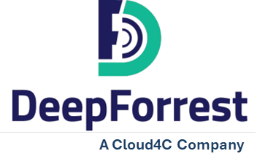
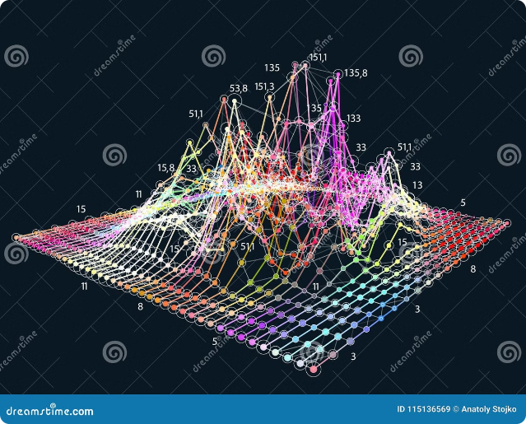
Exploring the World of RAG and GraphRAG

Slide 2
Agenda
What is RAG?
RAG architecture
RAG disadvantages
What is knowledge graph?
GraphRAG and its advantages
GraphRAG architecture
GraphRAG Deployment

Slide 3
What is RAG?
Definition
Key Capabilities
Applications
RAG is a technique to improve LLM outputs using real-world information. This technique is an important part of most LLM-based tools and the majority of RAG approaches use vector similarity as the search technique, which we call Baseline RAG.
RAG effectively searches through private datasets to find the most relevant information.
RAG has applications in areas like question-answering, dialog systems, and content generation, where access to external knowledge can improve the quality and accuracy of the output.

Slide 4
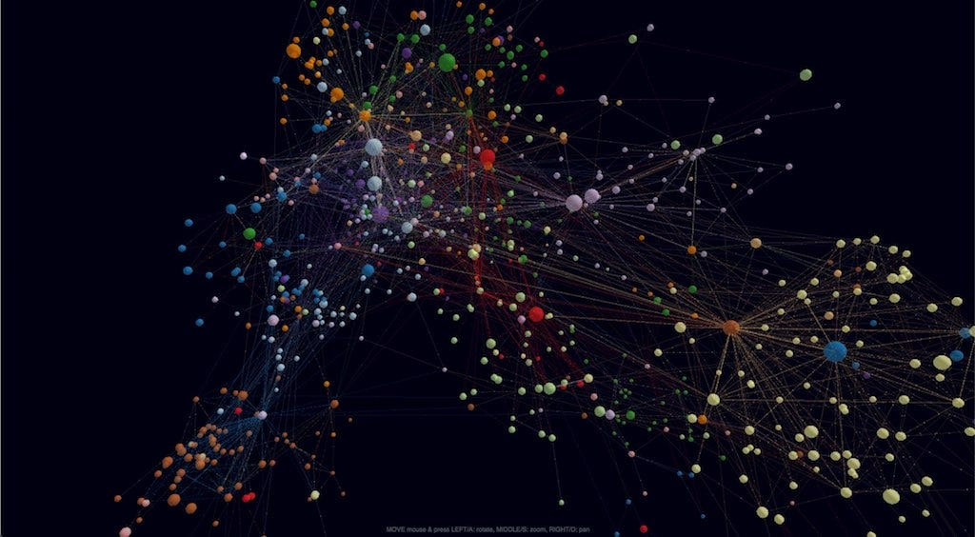

RAG Architecture
Encoder
Retriever
Decoder
The encoder takes the input text and generates a contextualized representation.
The retriever module identifies and extracts relevant information from external knowledge sources based on the input.
The decoder takes the encoded input and the retrieved information to generate the final output.

Slide 5
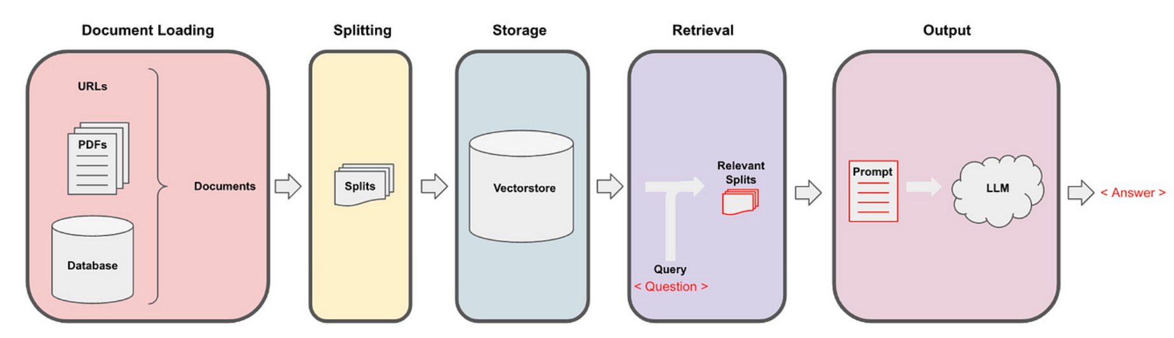
RAG Architecture

Slide 6


RAG Disadvantages
1
Flat Retrieval:
RAG treated each document as an isolated piece of information. Imagine reading individual book pages without knowing how they connect. This approach missed out on the deeper relationships between different pieces of information.
2
Coherence Issues
Without understanding the relationships and context, the AI could provide less coherent responses. It was like having a librarian who knows where to find books but doesn’t understand the connections between the stories in them.
3
Scalability Issue:
finding the right documents became slower and more complex, much like trying to find a specific book in an ever-expanding library.

Slide 7
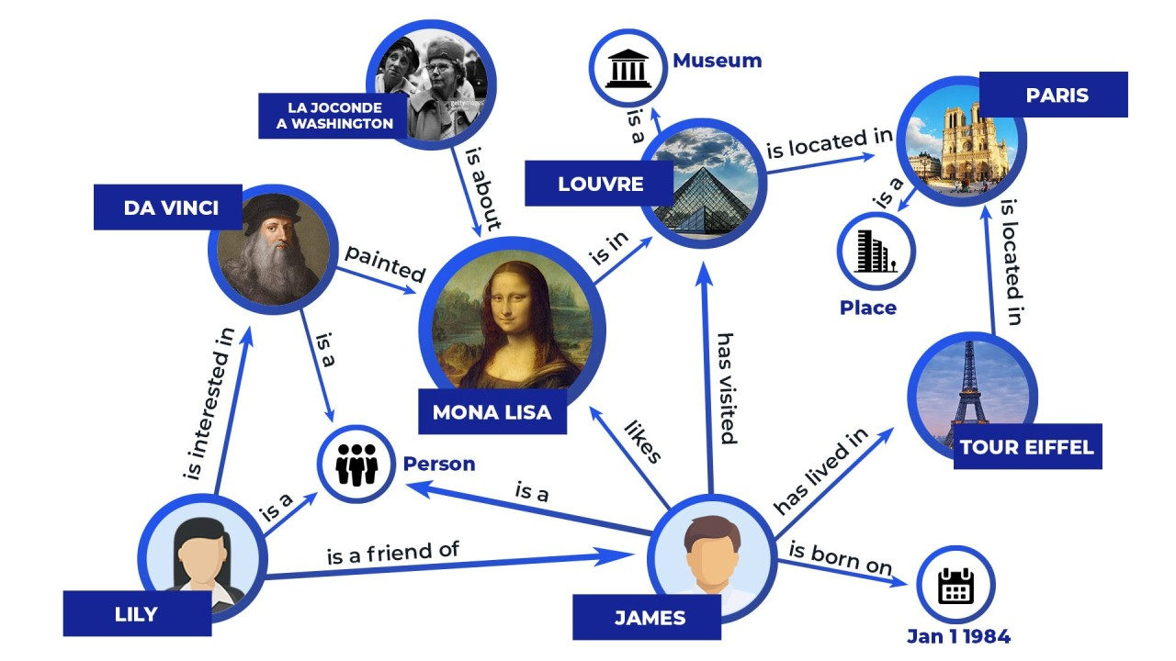
What is Knowledge Graph?
Structured Knowledge Representation
A knowledge graph is a structured representation of information that captures entities (e.g., people, places, things) and the semantic relationships between them. It is essentially a network of connected data points that provides a way to organize and link diverse pieces of information in a meaningful way.
Semantic Understanding:
Knowledge graphs are built to understand and represent the meaning of data, making it easier to retrieve and use the information effectively.
Used by
Google & Youtube.

Slide 8
GraphRAG And its Advantages
GraphRAG is a structured, hierarchical approach to Retrieval Augmented Generation (RAG). The GraphRAG process involves extracting a knowledge graph out of raw text, building a community hierarchy, generating summaries for these communities, and then leveraging these structures when perform RAG-based tasks.
Structured Knowledge Representation:
Efficient Processing:
Query Handling:
GraphRAG uses knowledge graphs to represent information, capturing entities, relationships, and hierarchical structure.
Pre-processing data into a knowledge graph enables faster retrieval compared to traditional RAG approaches.
GraphRAG can handle complex queries by synthesizing relevant information from multiple parts of the knowledge graph.

Slide 9
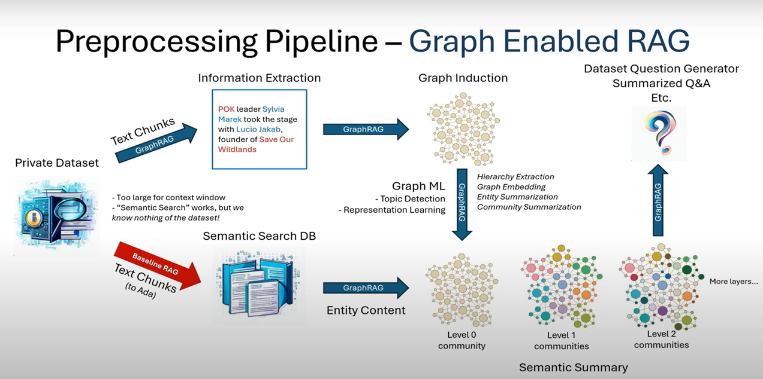
GraphRAG Architecture

Slide 10
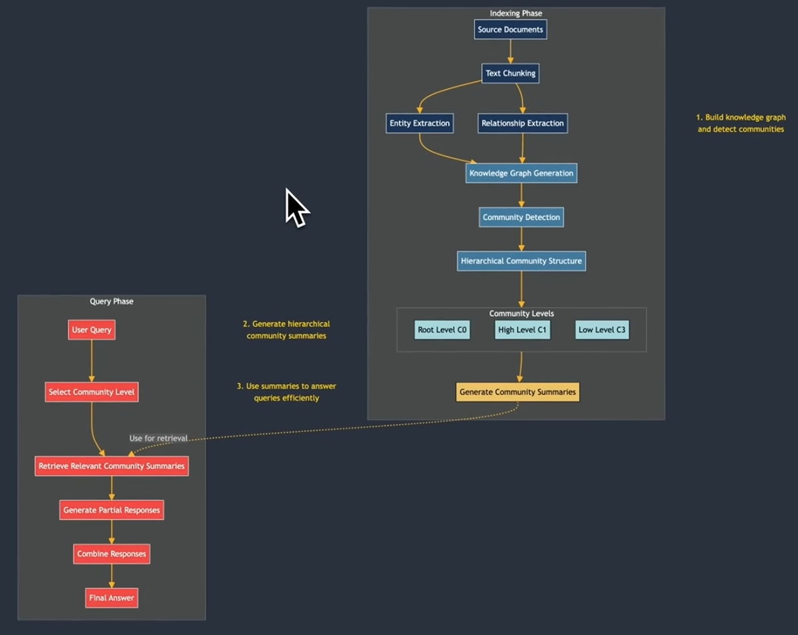
GraphRAG Architecture

Slide 11

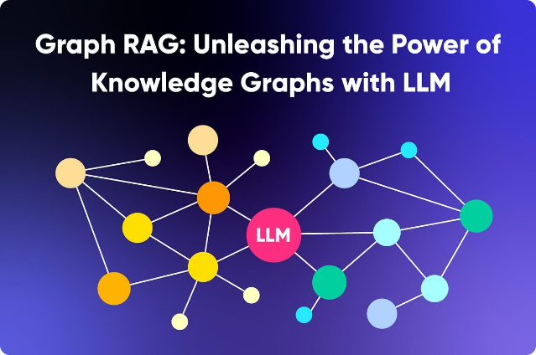
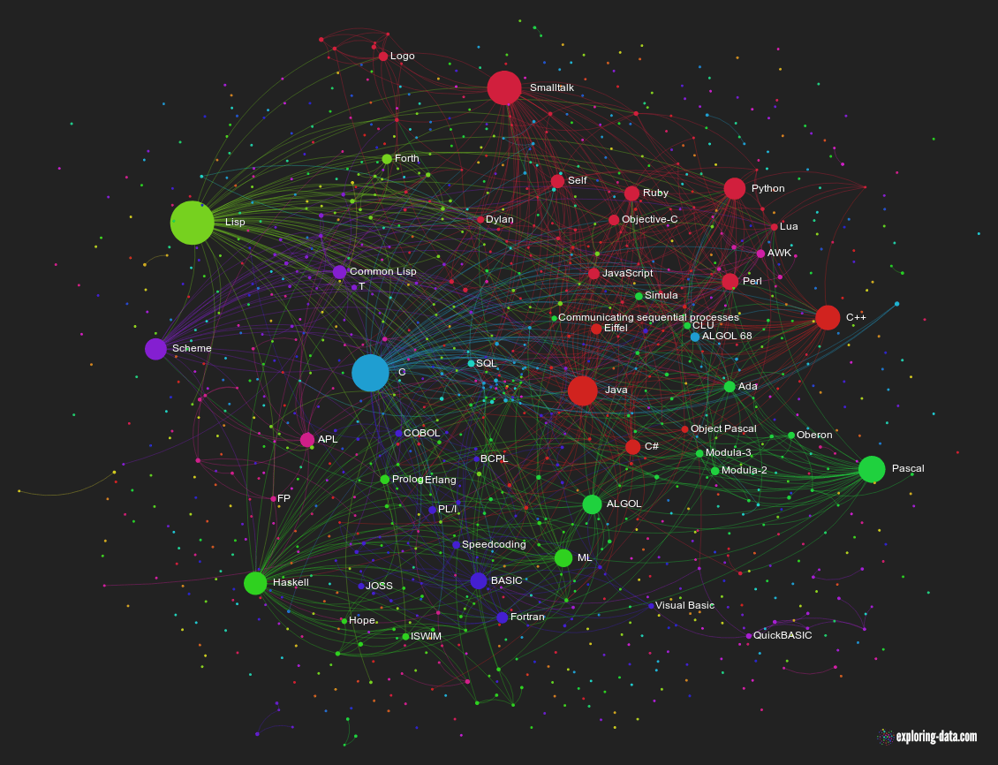
Deployment of GraphRAG

Slide 12
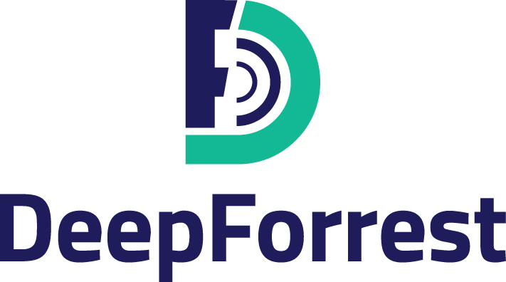
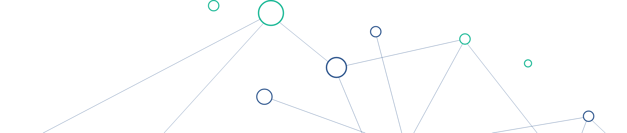
Thank You

